Slide 1
SIGNAGE TEMPLATE INSTRUCTIONS
Determine which items should be recycled, composted and/or landfilled in your operations.
Add text in the text boxes on Page 2 (“Recycle”), 3 (“Compost”) and/or 4 (“Landfill”) to describe which items should be recycled, composted and/or landfilled. See sample text on on slide 5, if needed.
Add images in the white spaces on Page 2 (“Recycle”), 3 (“Compost”) and/or 4 (“Landfill”) to visually show which items should be recycled, composted and/or landfilled. Use the sample images provided in our FSP Photo Gallery.
Print signs and place on or near your program bins, both front- and back-of-house.
Tips:
Determine whether you need different signage in the front-of-house (geared to customers) versus back-of-house (geared to staff). Most likely, you will.
Keep signage updated with any new materials you add to your programs.
Other suggestions:
Personalize to your operations as much as possible through text or images.
Do not use the same text/images on multiple pages. This may confuse the reader.
Include specific instructions as needed, like “replace cap and recycle.”
Check out our samples on pages 8-9 for ideas.
This template was created by FPI, for more information please visit www.recyclefsp.org.

Slide 5
SUGGESTED TEXT
For Paper Items (add “Paper” if needed)
Bags
Bowls
Boxes
Cartons
Chopsticks
Containers
Cups
Napkins
Newspapers/Magazines
Plates
Tray Liners
Wraps
For Other Items
Cans
Foil Containers
Foil Wraps
Food Scraps
Glass Bottles/Jars
For Plastic Items (add
“Plastic” if needed)
Bags
Bottles
Bowls
Containers
Cups
Cutlery
Foam
Lids
Plates
Straws
Note: You may also want to use descriptors like:
Compostable
Food soiled

Slide 6
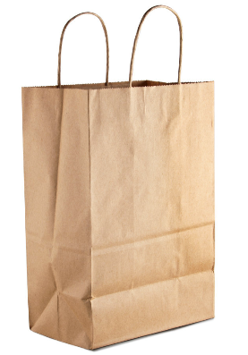
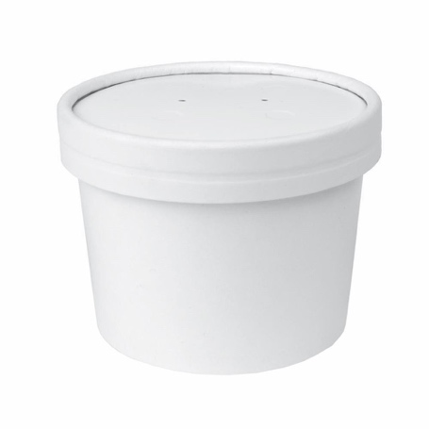
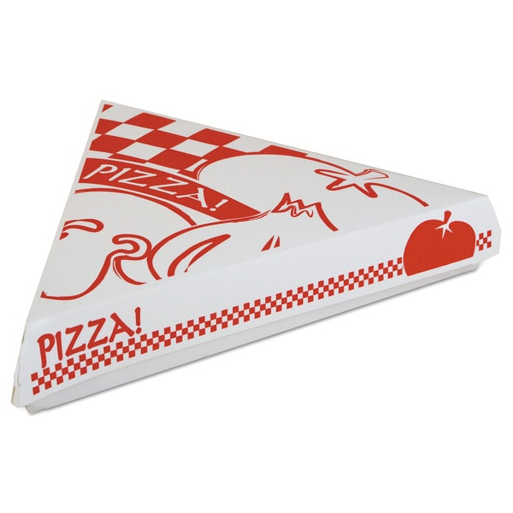
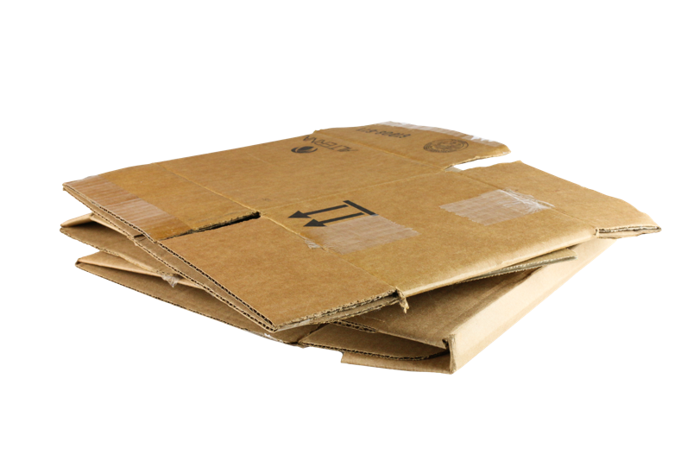
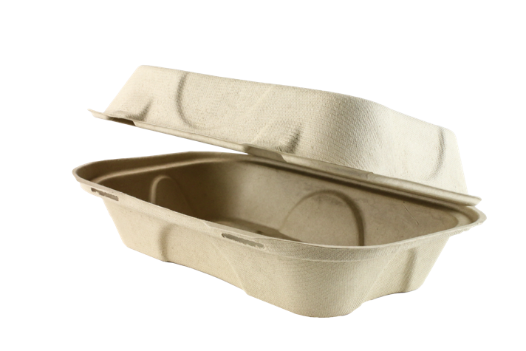

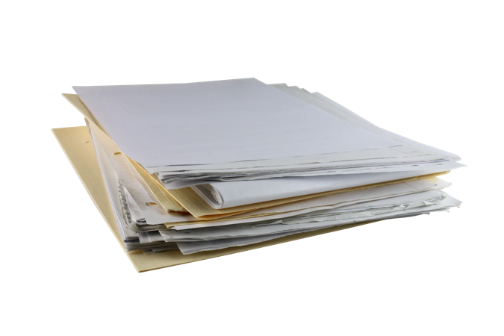
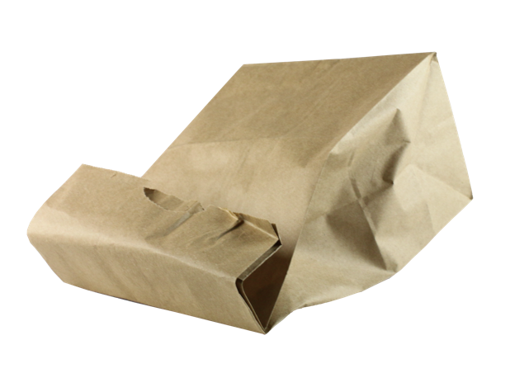
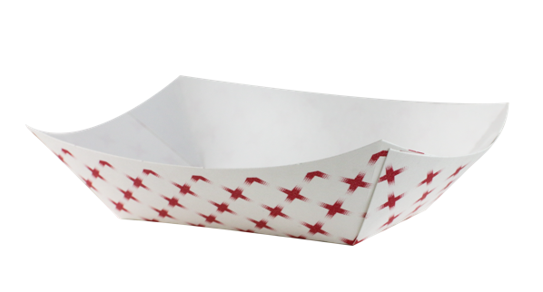
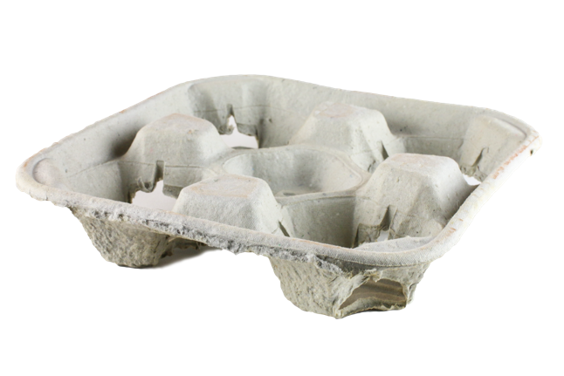
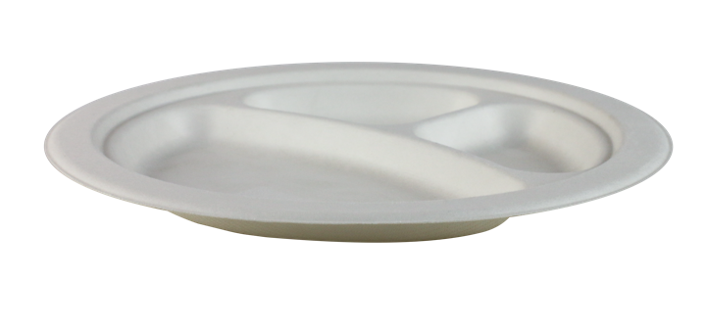
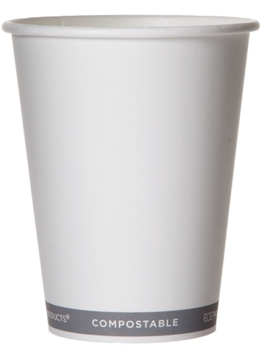
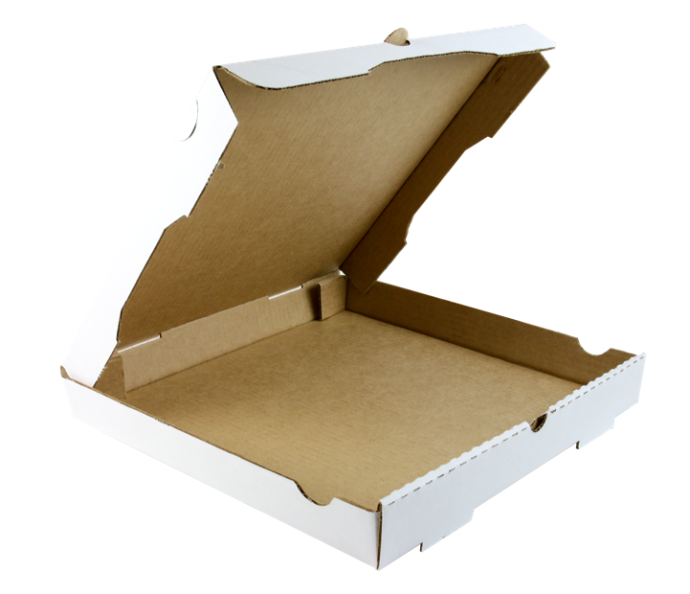
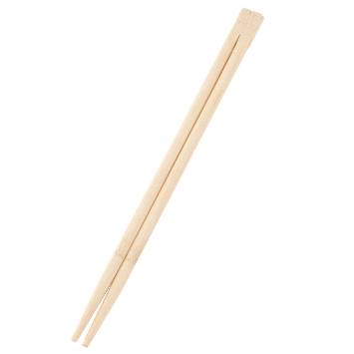


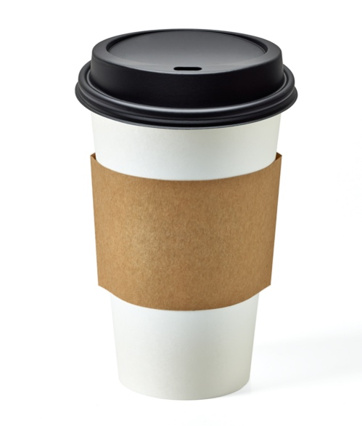
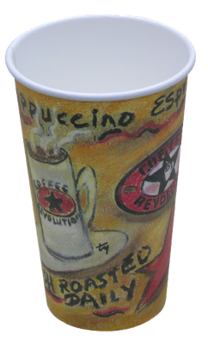
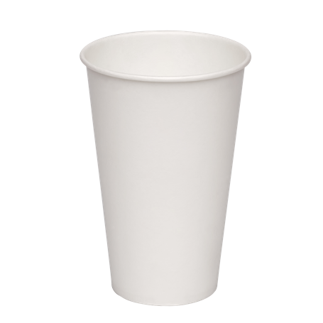
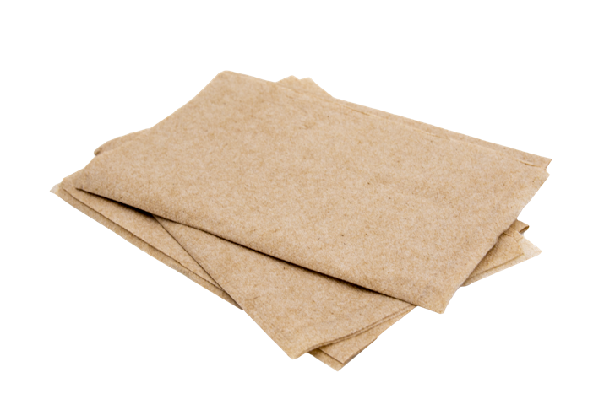
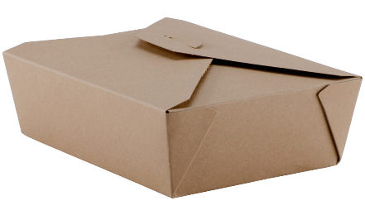
PAPER ITEM IMAGES

Slide 7
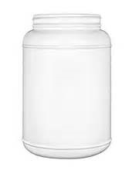

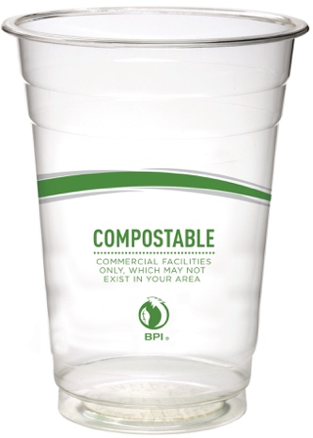
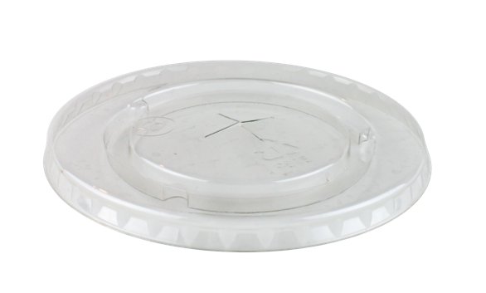
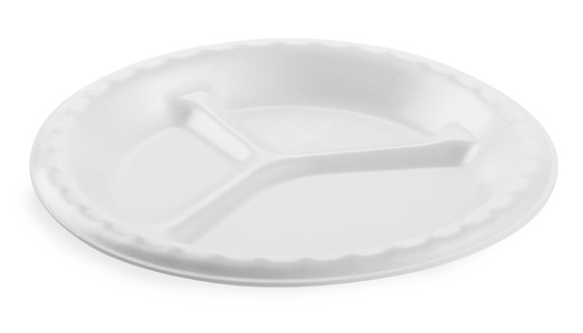
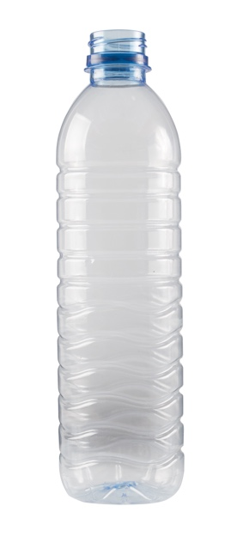
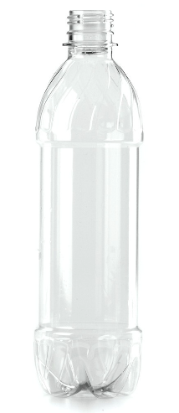
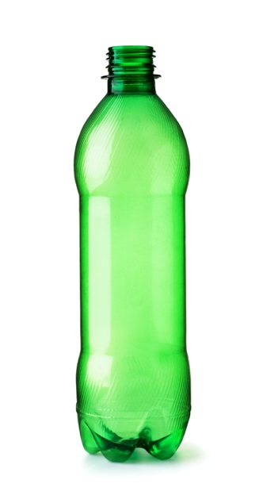
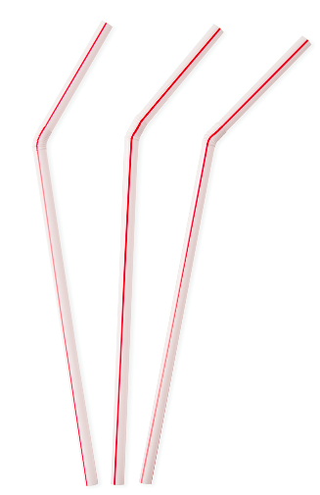
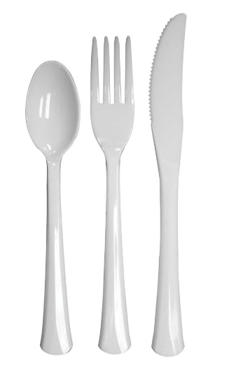
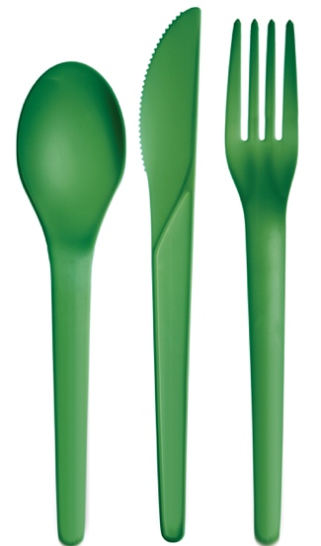
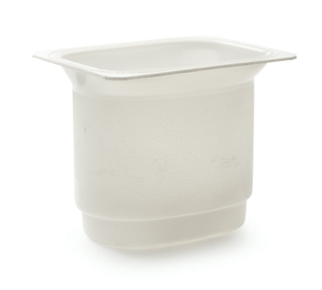
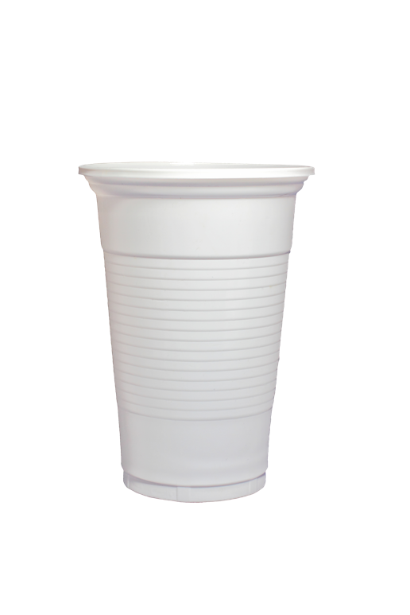
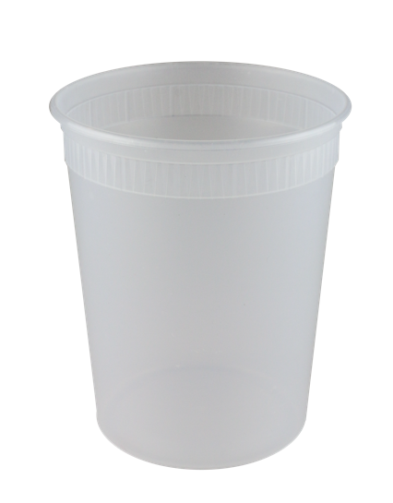
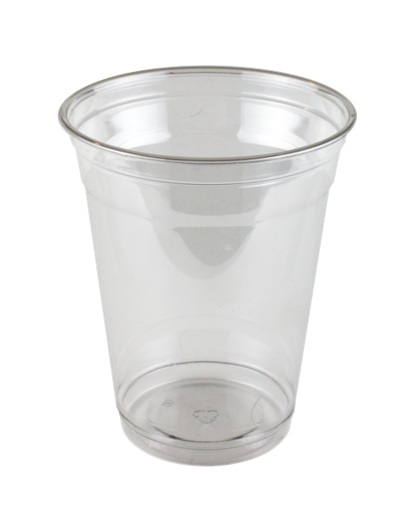
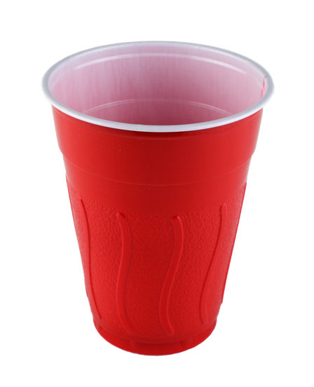
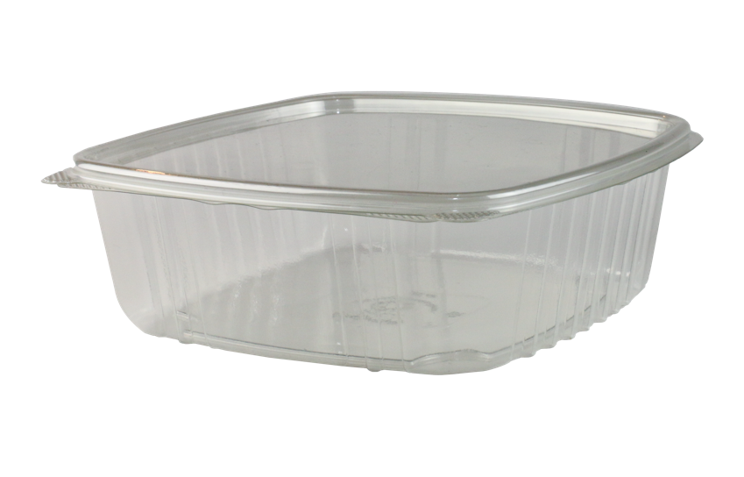
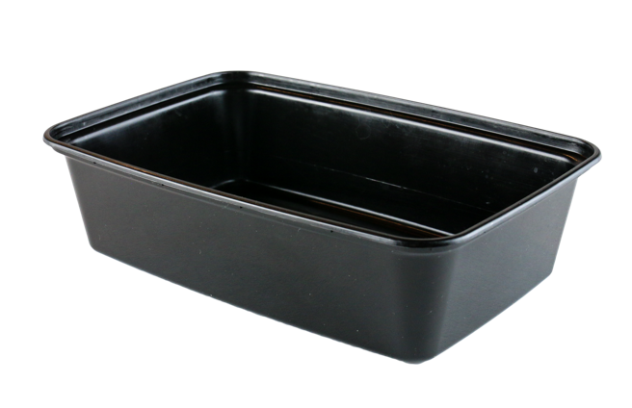
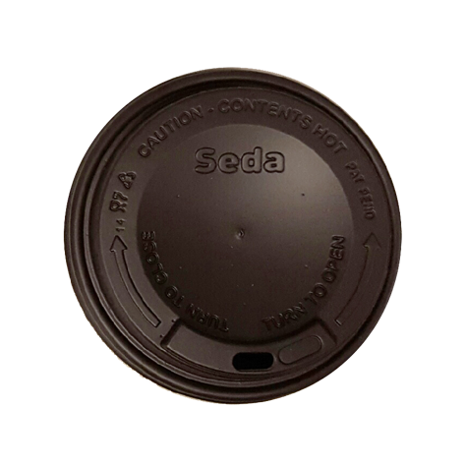
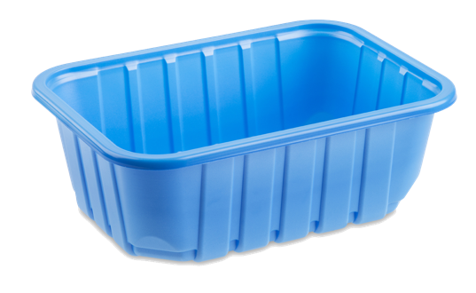
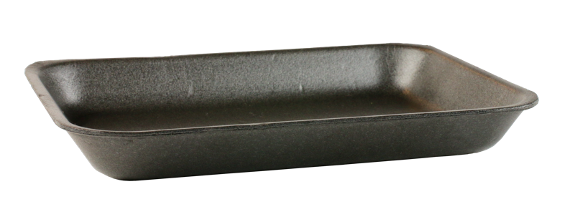
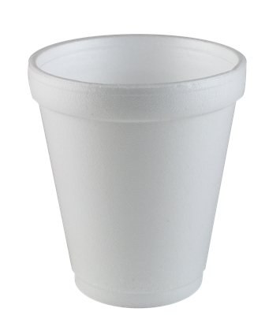
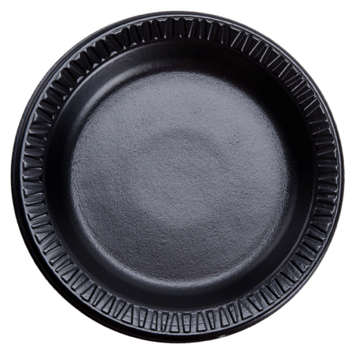
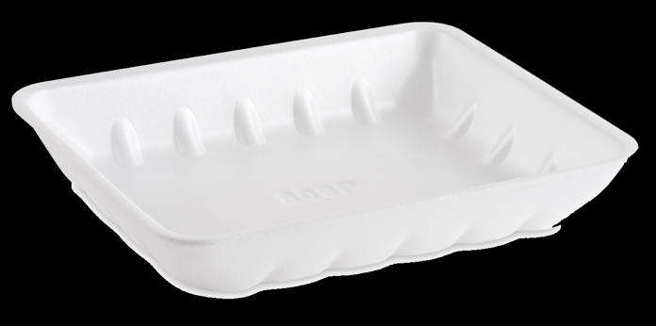
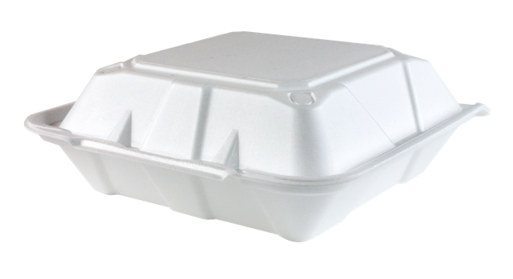
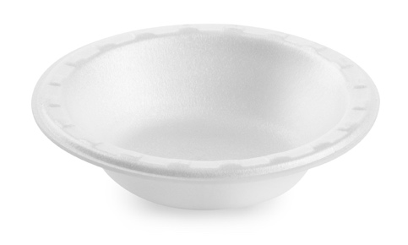
PLASTIC ITEM IMAGES

Slide 8


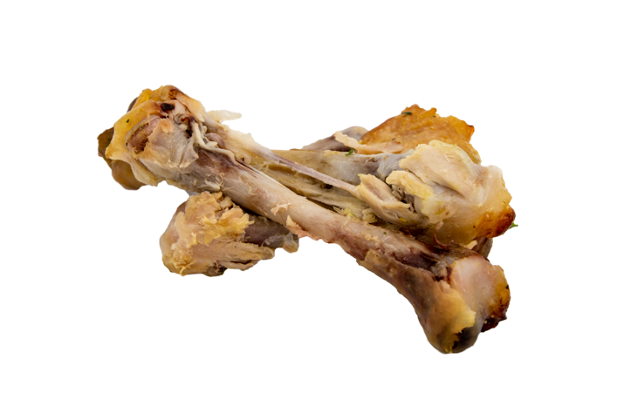
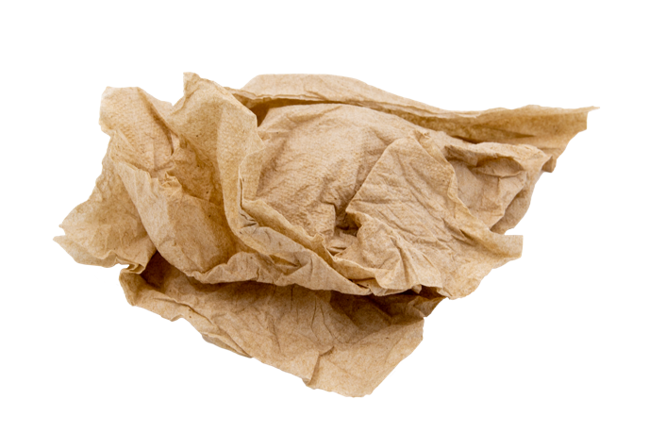
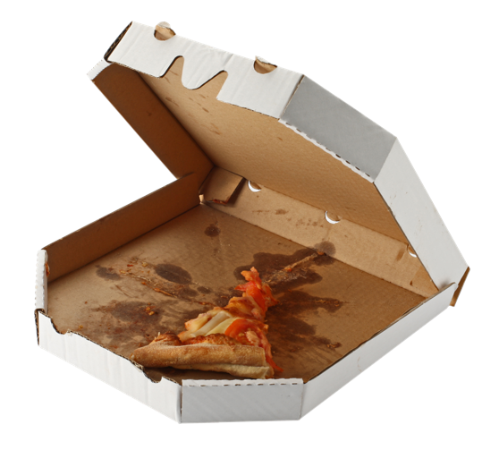
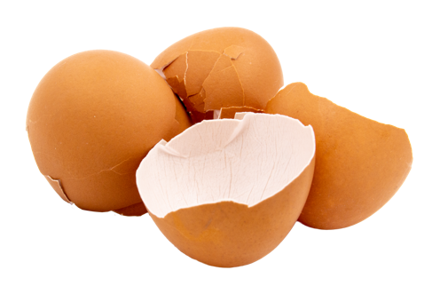
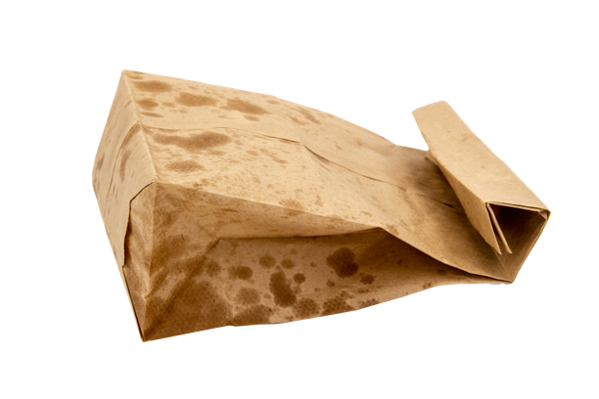
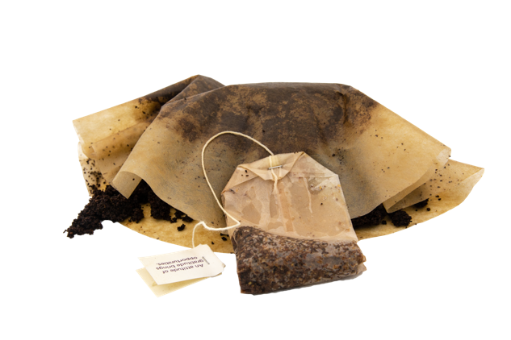
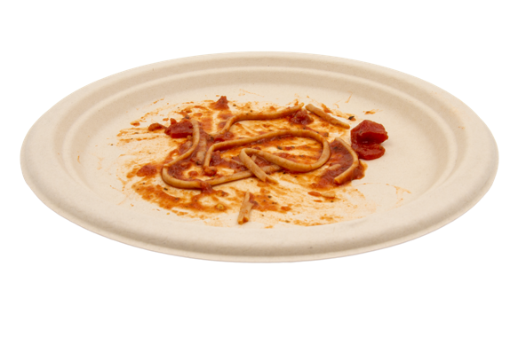











OTHER IMAGES

Slide 9









PLASTIC CUPS/BOTTLES/CONTAINERS • CANS • FOIL • PAPER CUPS • GLASS BOTTLES/JARS • CARTONS • FOAM • PAPER BAGS
EXAMPLE

Slide 10







FOOD SCRAPS • PAPER NAPKINS/CONTAINERS/PLATES • COMPOSTABLE PLASTICS • CHOPSTICKS
EXAMPLE

